Slide 1


Bunched Random Forest in Monte Carlo Risk Simulation
Eina Ooka
May, 2017
R/Finance 2017
In Chicago

Slide 2

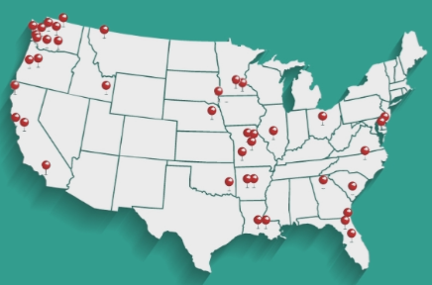
Power Utility Industry
The Energy Authority serves public utilities nationwide for trading and analytics.
Mid-term (1 month – 5 years) portfolio management.
Stochastic simulation models for energy and gas market.
Notes:
My name is Eina Ooka, and I work for The Energy Authority that serves public utilities nationwide for trading and analytics services.
My particular focus is mid-term portfolio management, and for this purpose, I build and run stochastic simulation models for energy and gas wholesale markets.

Slide 3

MC Simulation Approach
Natural Gas
Coal Resources
Natural Gas
Market settlement prices
NG Resources
NG Resources
Power Prices
Power Prices
Power Prices
Power Prices
Runoff/Hydro Forecast
Wind + Solar generation
Load
Load
Hydro generation
Notes:
Utility portfolios usually involve multiple components, including thermal generation resources like coal or natural gas.
They may own shares of wind, solar, or hydro generation. And Utilities usually serve loads.
In order to capture the risk of the entire portfolio, I need to capture cashflow of all these components stochastically. And in order to capture cash flow, I need to run a Monte Carlo simulation for gas and power markets that feeds into generation dispatch models.

Slide 4
MC Simulation Approach
Heston
Natural Gas
Coal Resources
Natural Gas
External Information
Dispatch Simulation
Bunched Random Forest
NG Resources
Market settlement prices
NG Resources
ARIMA
Power Prices
Exogenous Inputs
Power Prices
Power Prices
Power Prices
Markov-Chain
Runoff/Hydro Forecast
Wind + Solar generation
ARIMA
Load
Load
Hydro generation
Optimization
Notes:
However, all these time series exhibit different time series characteristics. So, as you see in the diagram, I employ multiple different methodologies to capture this entire system.
The one I’d like to particularly focus on today is the middle one, generation of power prices, using what I call Bunched Random Forest. Power prices are non-linear functions of other stochastic variables like gas and loads, and it is fed into the thermal dispatch simulation models. This structure makes it important that I capture all power price time series characteristics.

Slide 5
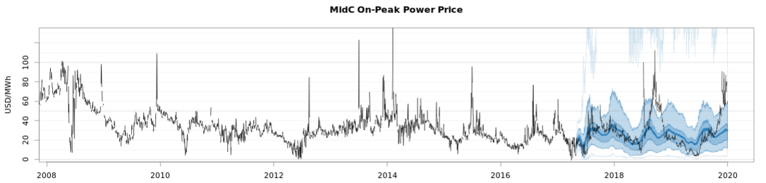
Power Price TS Characteristics
Autocorrelation
Seasonal and weekly shapes
Volatility & Heteroscedasticity
Seasonal and weekly variability
Multivariate cross-correlation and non-linear dependency
NG, load, regional hydro and other variable generation
Non-normal distributions
fat tails
Extreme peaks and drops
Negative prices
Consistency with market expectations
Consistency between monthly, daily and hourly data.
Notes:
The characteristics includes autocorrelation, seasonal and weekly shapes. It’s heteroscedastic and in fact volatility tends to have seasonal and weekly shapes themselves. We need to capture multi-variate cross correlation and non-linear dependency onto other variables. Distribution tends to be non-normal and usually includes fat tails, extreme peaks and some negative values. While achieving all these, we’d like to make sure that result is consistent with market expectations in different time granularity.

Slide 6
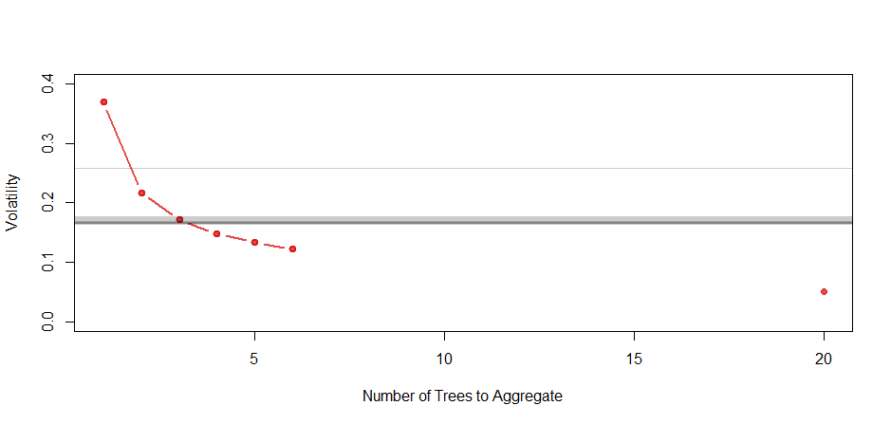
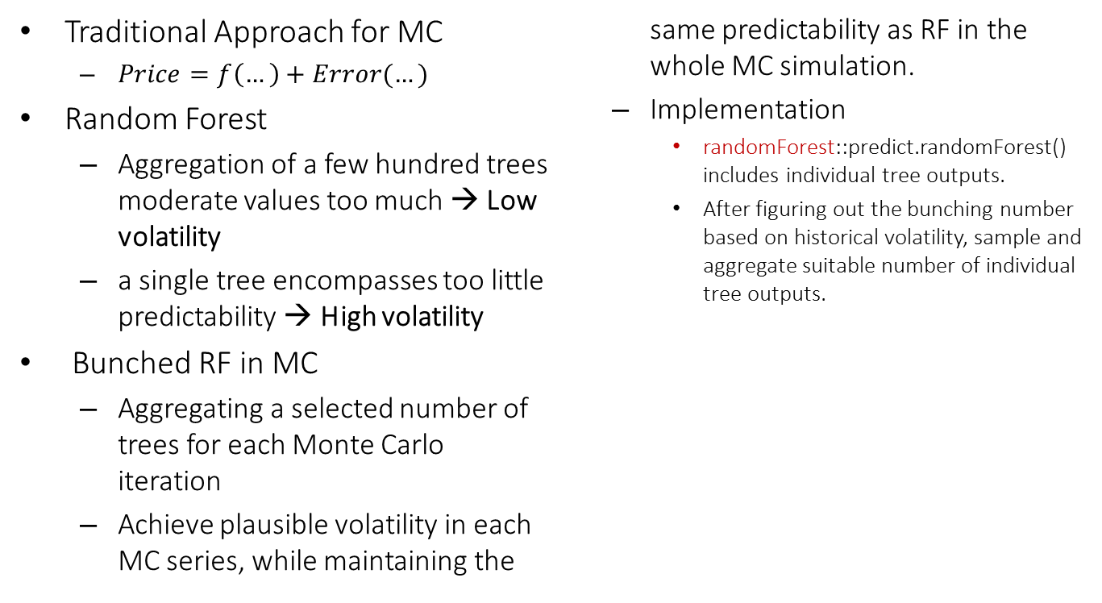
Bunched Random Forest
Traditional Approach for MC
$Price=f\left(…\right)+Error(…)$
Random Forest
Aggregation of a few hundred trees moderate values too much → Low volatility
a single tree encompasses too little predictability → High volatility
Bunched RF in MC
Aggregating a selected number of trees for each Monte Carlo iteration
Achieve plausible volatility in each MC series, while maintaining the same predictability as RF in the whole MC simulation.
Implementation
randomForest::predict.randomForest() includes individual tree outputs.
After figuring out the bunching number based on historical volatility, sample and aggregate suitable number of individual tree outputs.
Simulated
Historical
… 300
Notes:
Traditional Monte Carlo methods are usually in a form of a predictive component, f, plus some error component. Both predictive and error components can be function of autoregressive terms and exogenous variables, but in my experience, getting the error terms correctly is an involved process, and that’s when I started experimenting with Random Forest models.
Random Forest model aggregates a large number of decision tree outputs in order to achieve a stable accurate forecast value. However it moderates values too much to capture correct volatility level, if I had applied Random Forest to each Monte Carlo iteration.
On the other hand, each tree presents too little predictability and generated too high of a volatility, if I had applied each tree output to each iteration.
So my natural answer was then to aggregate a selected number of trees for each iteration, so that I can achieve correct volatility level for each Monte Carlo iteration while also achieving similar accuracy as the whole Monte Carlo simulation as original Random Forest model. The right bottom chart shows that as I aggregate more number of trees, resultant volatility comes down. In this particular case, I’d like to aggregate 3 trees for each iteration in order to achieve similar volatility to historical level.
You can easily implement this logic using the existing CRAN package “randomForest” and use individual tree outputs.

Slide 7
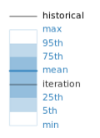
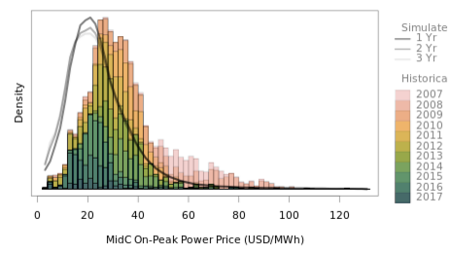
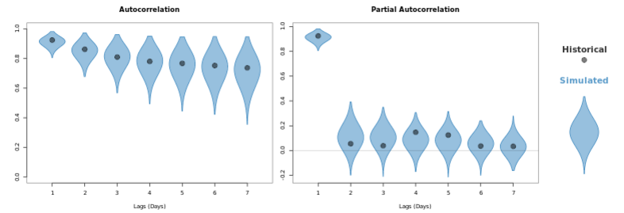
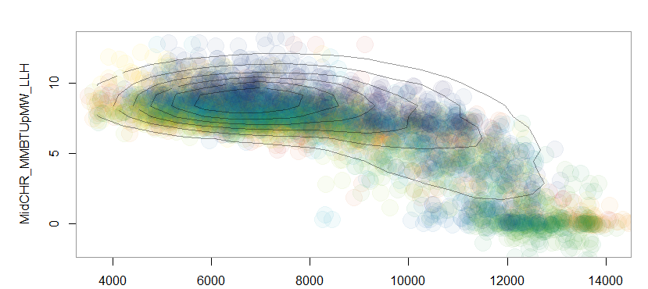
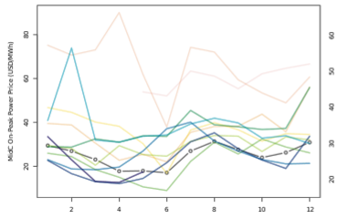
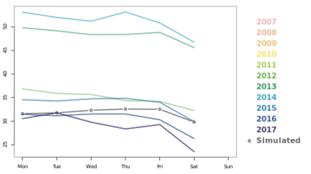
Results
Mid-C Power Price (Historical + Simulated)
Price Distribution
Autocorrelation
MidC Power Heat Rate (mmBtu/MWh)
Seasonality
Weekly Shape
Non-linear dependency on regional hydro
Regional Hydro Generation (aMW)
Notes:
By deploying Bunched Random Forest, I could reasonably achieve all characteristics that I had mentioned.

Slide 8
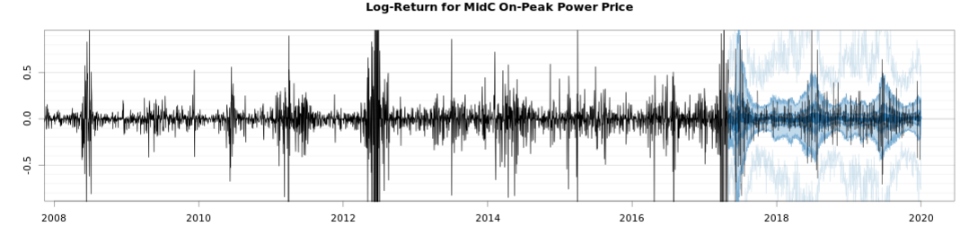
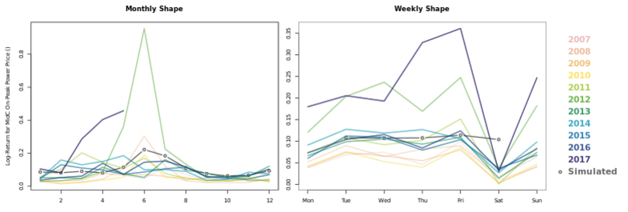
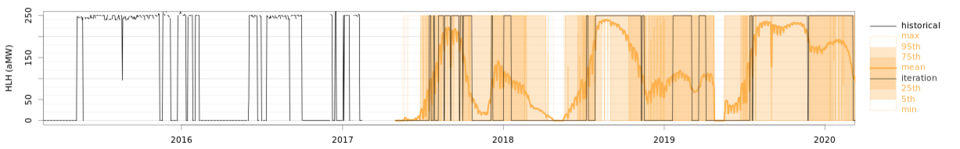
Results
Power Price Log-Returns (Historical + Simulated)
Scoring
Pinball-loss scoring for stochastic forecasting
Need to achieve all time series characteristics.
Volatility, seasonality, moments, …
A visual inspection with heuristic reasoning is sometimes necessary.
Backcast and feed the generated power prices to Natural Gas dispatch model, and look at pinball-loss scoring on generation outputs.
Seasonality in Volatility
Natural Gas Resource Dispatch (Historical + Simulated)
Notes:
One last comments on scoring before I end here. I generally use pinball-loss function for stochastic forecast scoring. However, pinball or any other scoring is only one measure of the model performance and when I have so many different characteristics that I have to capture, no one score is comprehensive enough. So I rely on visual inspection with heuristic reasoning for validation. That said, the resultant power price series are fed into resource dispatch model and dispatch model is sensitive to many of the power price characteristics. So I’ve found that calculating pinball-loss score on resource outputs instead the power price series is a very effective measure of the model performance.

Slide 9

More on utility portfolio modeling on my poster from
UseR 2016:
https://github.com/
einaooka/useR2016
Thank you!
Contact:
eooka@teainc.org
! The Energy Authority is looking for an intern.
Notes:
That’s it. Our seattle office is looking for an intern. Thank you!

